Slide 1
Introduction to
GUI Frameworks: Qt Slint Flutter
KSOE, Korea
CHRISTOPH Sterz

Slide 2



Contents
This Presentation will introduce the 3 GUI Frameworks
  Qt
  Flutter
  Slint
The KSOE POC was implemented 3 Times (For each Framework)
This presentation introduces History, Languages, and UI concepts
The Information will guide KSOE engineers and management

Slide 3
History - Overview
QML
Qt4
2004
Qt5
2012
Qt6
2020
Dart
2011
Flutter
2017
Software & GUI
Frameworks
Rust
2010
Slint
2020
iMX6
2011
iMX8
2017
Hardware
X2 Panel Release
2016

Slide 4
Qt is the Oldest
QML is medium-old
Qt is by far the oldest GUI Framework (1995)
Qt ist based on the programming Language C++ (1985)
Almost all Qt Touch-GUIs are programmed in QML (2011)
There is the option of programming in python instead of C++ since 2019.
Qt Changed Owner Multiple times
    1991 – 2008 Trolltech
    2008 – 2011 Nokia
    2011 – 2014 Digia
    2014 – Now The QtCompany

Slide 5
Qt Program Architecture
Qt is Cross-Platform. (Windows, Linux, Mac, (WinCE), QNX, (VXWorks), (Integrity), (MCU))
Qt Libraries can perform almost all OperatingSystem Tasks
  Network Access
  Sound, Bluetooth, …
  Device Access
  File Access
  Drivers (CAN, Modbus, …)
QML UI-Programming
C++ Logic
C++ Logic
QML Engine
Qt Libraries
Qt Libraries
Operating System (Windows, Linux, Mac)

Slide 6
Qt Widgets on Desktop
Qt QML on Embedded
Faster, Destkop PC, Mouse+Keyboard
Slower, Embedded Hardware, Touchscreen
Widgets
QML

Slide 7
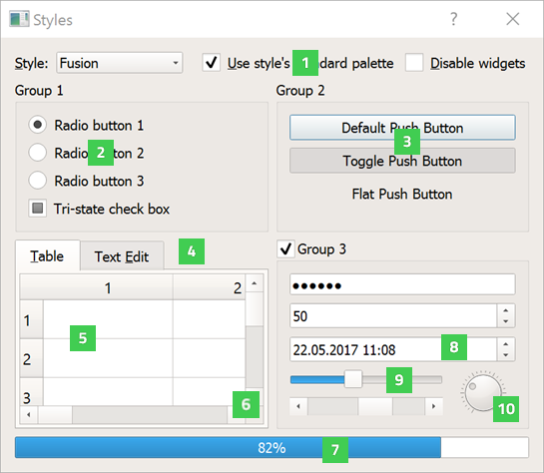
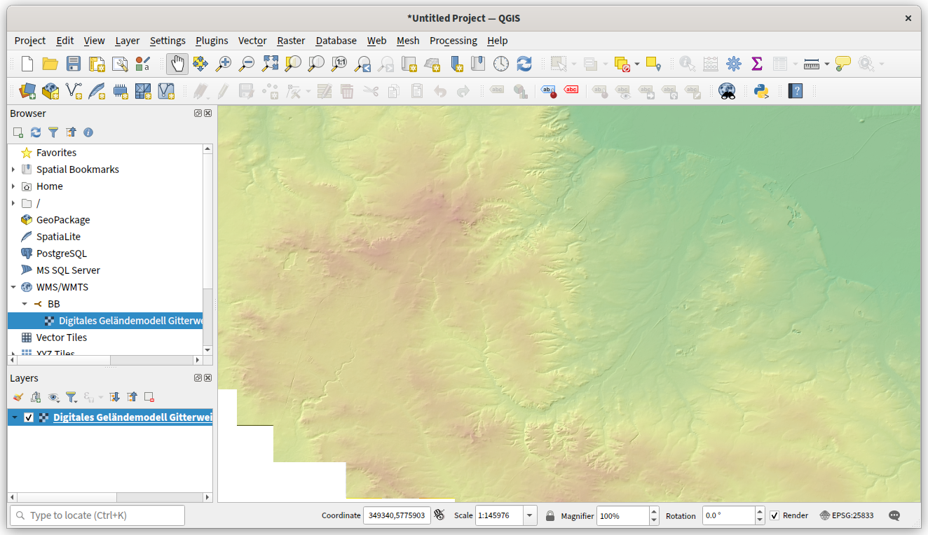
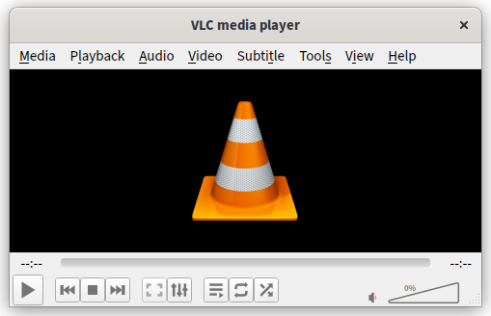
Qt Example Programs
Qt Widgets on Desktop
Widget Gallery
QGIS
VLC Player

Slide 8
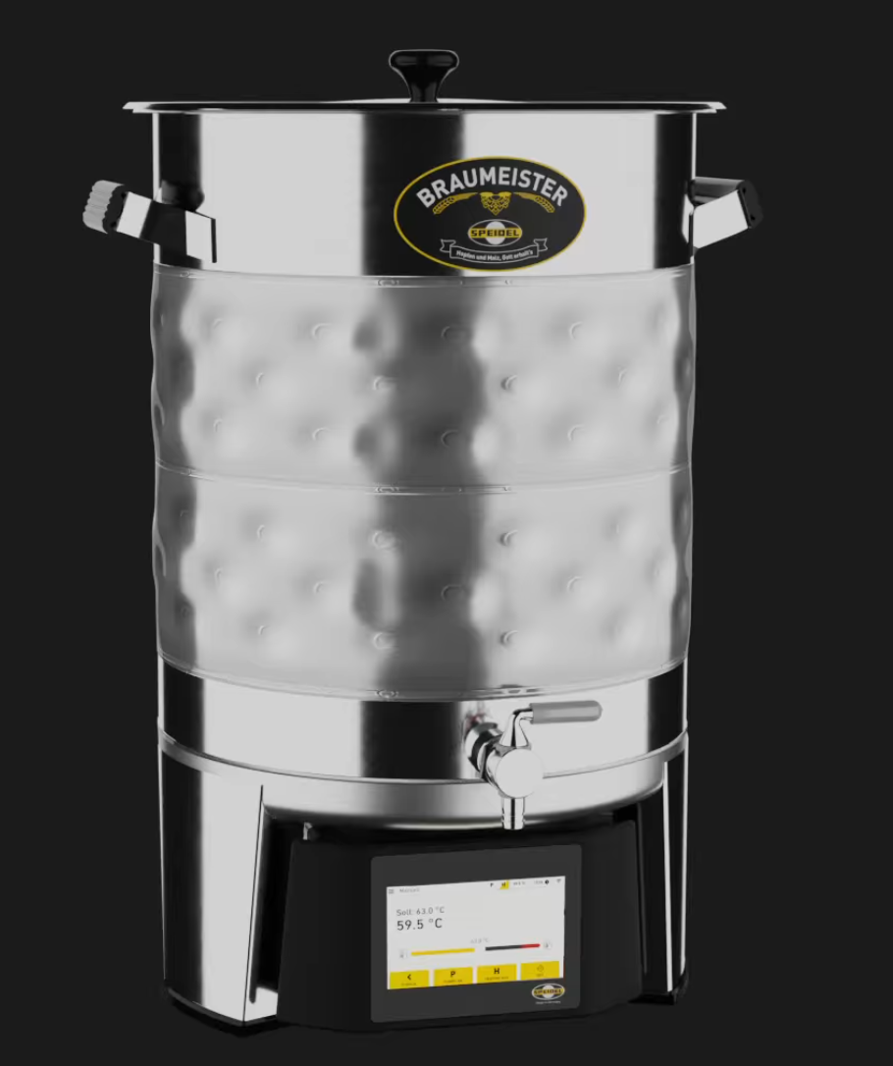
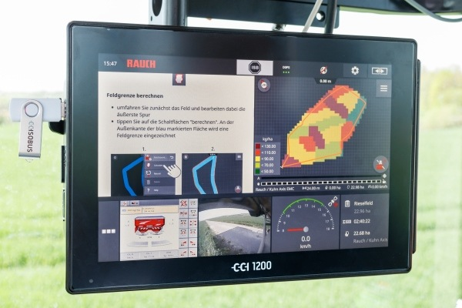
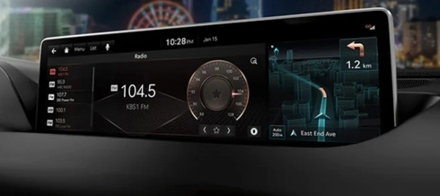
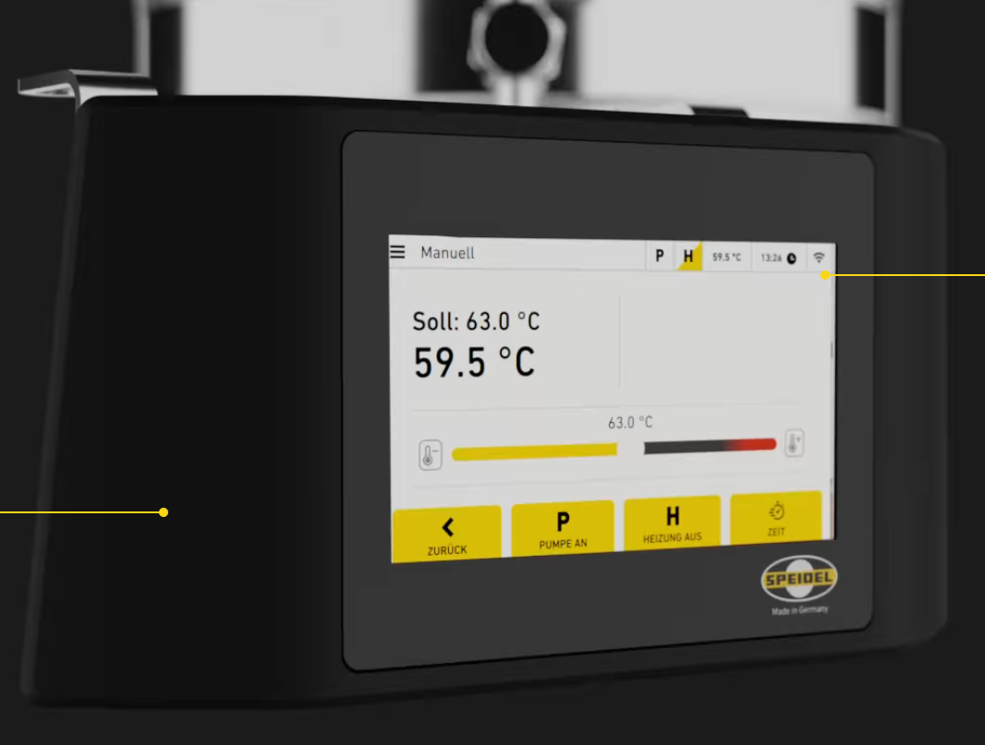
Qt Example Programs
Qt QML on Embedded
Hyundai Genesis Car
Farming / Tractors
Braumeister Beer Brewing

Slide 9
The Qt Embedded Programmer
Needs to know 2 Languages: C++ and QML
C++: High-Performance Datahandling and Business Logic
  Programmer will talk to the Backend-Programmer
  Access and Pre-process Datasources, Inform Backend about Changes in Data
QML: The Looks – UI only
  Programmer will talk to the Designer
  Screens, Elements, Colors, Animations

Slide 10
C++ And QML
C++: Data and Logic
QML: The Looks
//(C++)
InitializeSystem(…);
ReadMapData(…);
GetPosition(…);
DisplayBrightness(…);
GetWeather(…);
Update(…);
Reboot(…);
// QML
Window {
TitleBar {
Clock {…}
}
MainMap {
ShipMarker{…}
}
BottomBar {
InfoLine{…}
}
}

Slide 11
Compile Process
Test On Desktop (fast)
Test On Hardware (slow)
.h /.cpp
(C++)
.qml
(QML)
.h /.cpp
(C++)
.qml
(QML)
Qt
SDK
Cross-Compiler
Compiler
Copy
Check on
Desktop
Check on
Desktop
Check on
Panel

Slide 12
Interactive HelloWorld
At the End of this Presentation I will present a simple Hello World in all 3 Languages and show how the programming looks and feels like.

